Slide 1


Slide 2

APT Groups
Advanced Persistent Threats (APT’s)
27/11/2025

Slide 3
Don't do illegal shit…
Please…

Slide 4

Announcements
01
04
02
05
03
06
Red vs Blue (TBC)
New Hackers VM (CSC and GDrive)
Q-Zips, ready to order via Discord
New Weekly Schedule
27/11/2025
CTF Team sign ups
New Social Route going forwards

Slide 5



Today’s Session
Who?
What?
Why?
How?
Who are APT groups made of? What does an APT consist of?
What is an APT group?
What are the motivations of APTs and why do they do what they do?
How can we attribute an attack to an APT via the TTPs shown?
27/11/2025

Slide 6
What is an APT Group? (What?)
01

Slide 7
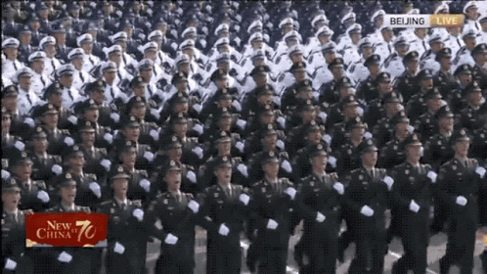

APT or Advanced Persistent Threat is the name given to a state sponsored group of threat actors with common goals aligning the state body of affiliation (usually)
An APT group due to the scale of funding and support from said state power, allows the delivery of much more prominent attacks, causing huge effect on the victim side.
Think Stuxnet, Solarwinds etc… Usually, APT groups are politically driven via the motives of their nation state…

Slide 8
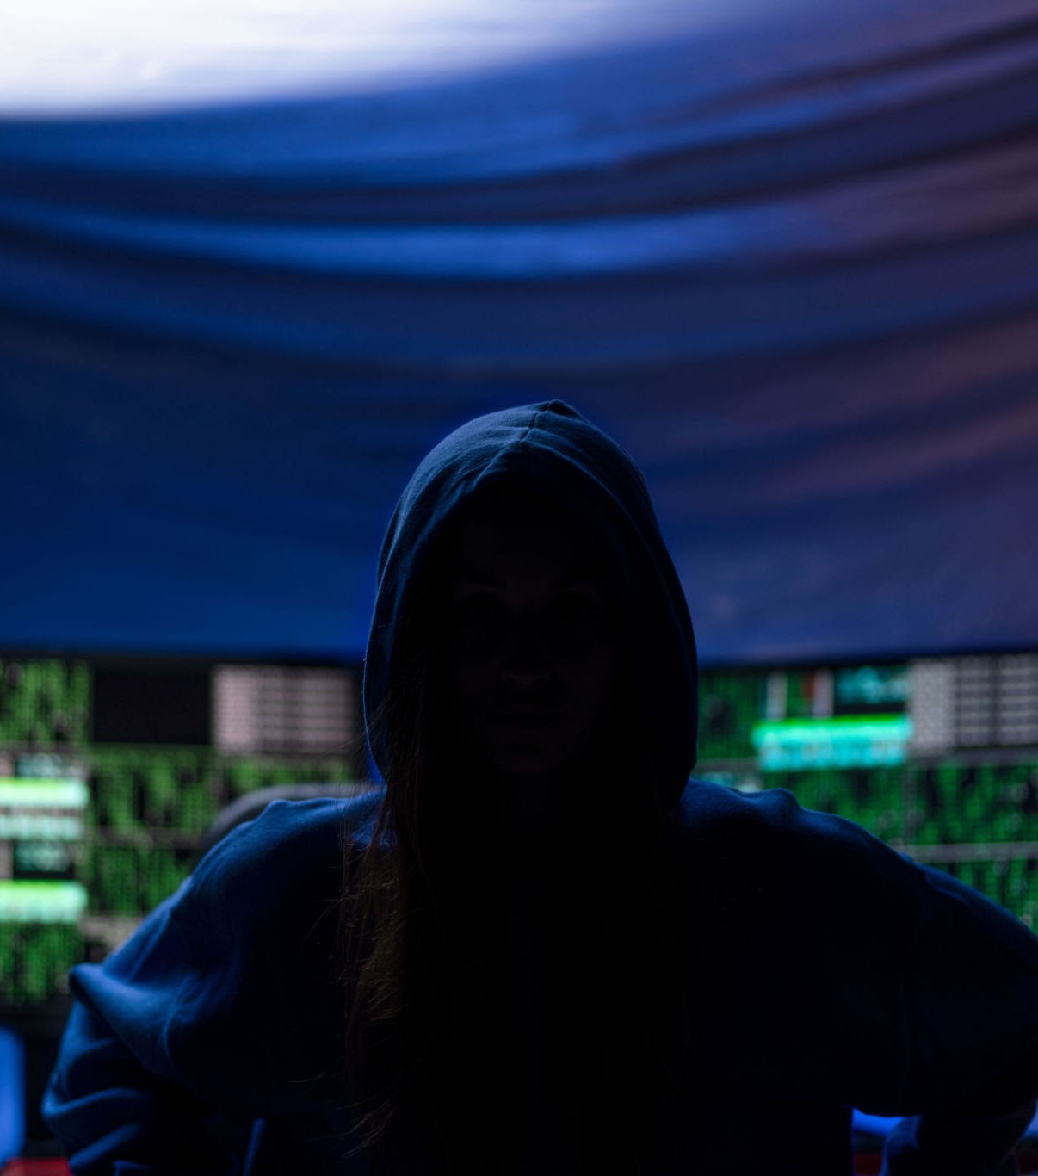
Other types of threat actor?
Before looking at motives, let’s look at other types of threat actor:
Hacktivist
Script Kiddie
Nation-State Actors (APT)
Cybercriminals
Insider Threats
Organised Crime Groups
Thrill Seekers
Cyberterrorists

Slide 9

Hacktivist
Goal:
Exposing secrets and disrupting an organisation they perceive to be “evil”
Typical Target:
Depends on the motives and drive of the hackers, not limited to any industry
Mitigation tactics:
General cybersecurity guidance, reduce attack surface, implement IRPs, tabletop exercises, harden the perimeter defences.
Calibre of attack complexity:
Low to moderate

Slide 10


Script Kiddie
Goal:
Attack, vandalise and inflict maximum damage with a script they have not read
Typical Target:
Low hanging fruit, widely known vulnerable targets
Mitigation tactics:
Get on top of recent patching and common vulnerabilities, consider taking up religion if they get hold of RaaS…
Calibre of attack complexity:
Low to low (unless they get lucky)

Slide 11

Advanced Persistent Threat (APTs)
Goal:
Destabilise nation states, disrupt major CNI and other process, steal critical information, generally… be a nuisance on an impressive scale
Typical Target:
Critical National Infrastructure, Supply Chain, Defence Industry, Government bodies
Mitigation tactics:
Do not upset ANYONE, realistically if you are the victim of a nation-state attack, even prayer may not be enough, STUXNET TOOK ADVANTAGE OF 4 ZERO DAY VULNERABILITIES!!!
Calibre of attack complexity:
HIGH to HIGH

Slide 12

Cyber Criminals
Goal:
Ransomware, exfiltrate data, anything that can generate some dosh!
Typical Target:
Financial institutions and businesses
Mitigation tactics:
Standard prevention and follow NCSC guidance as per ransomware/extortion
Calibre of attack complexity:
Moderate

Slide 13
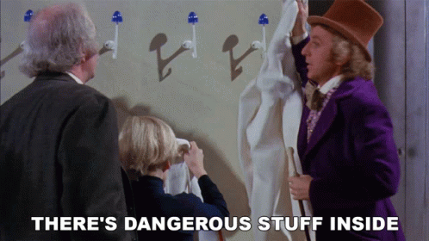
Insider Threat
Goal:
Either the victim of blackmail from an outsider, or a disgruntled employee looking to take revenge on the company OR the chatgpt warrior that accidentally takes down the entire corporate network… Insider threats may not even know that they are an insider threat…
Typical Target:
The institution they are a part of
Mitigation tactics:
Provide employees with a wellness lizard, or monitor RBAC and have process to revoke access control rights when required to employees offboarding etc
Calibre of attack complexity:
Low to High

Slide 14
Who are the hackers in an APT group? (Who?)
02

Slide 15
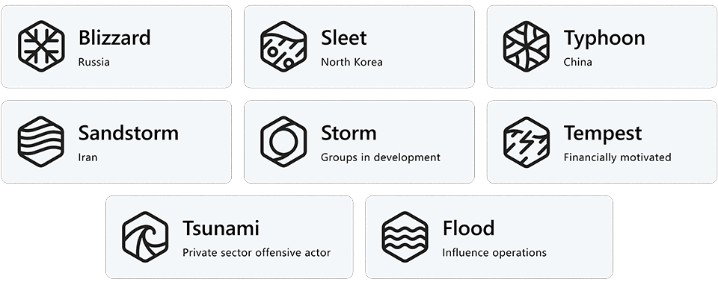
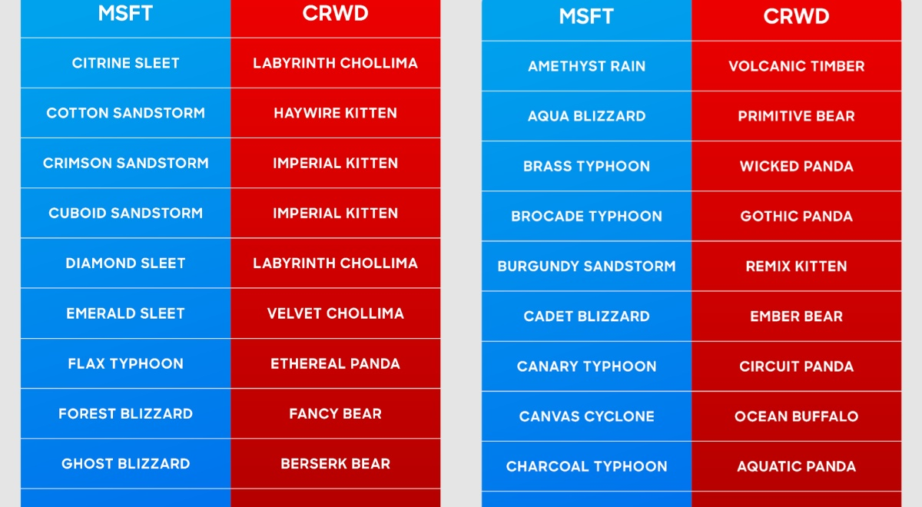
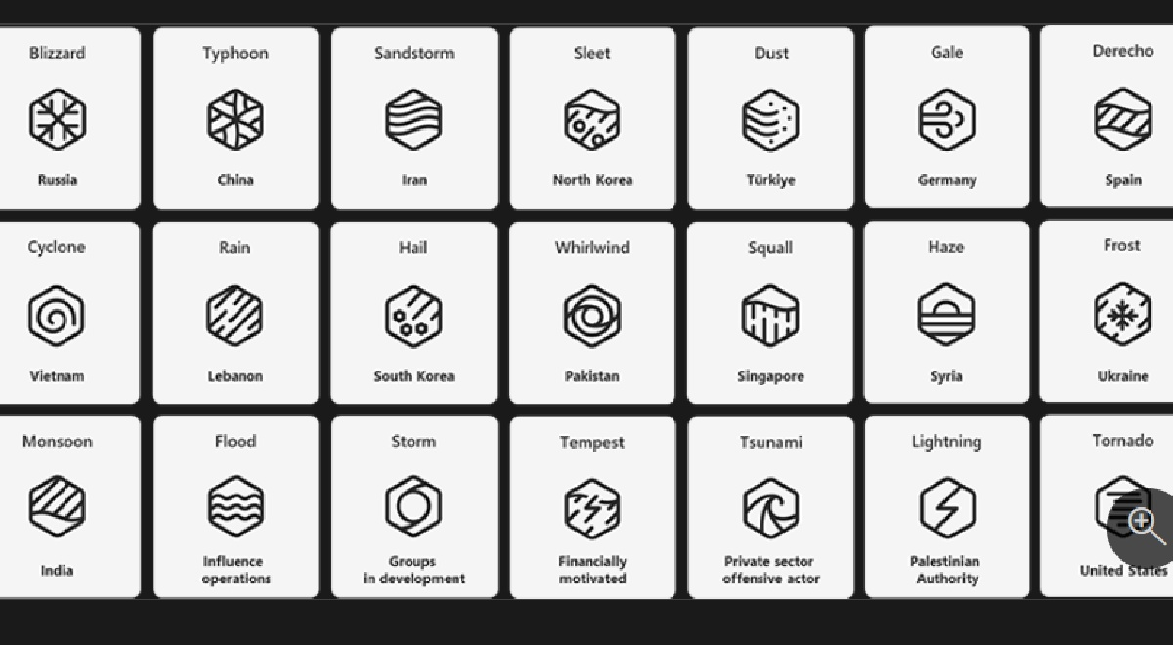
APT Group naming conventions
Notes:
Life is never simple

Slide 16
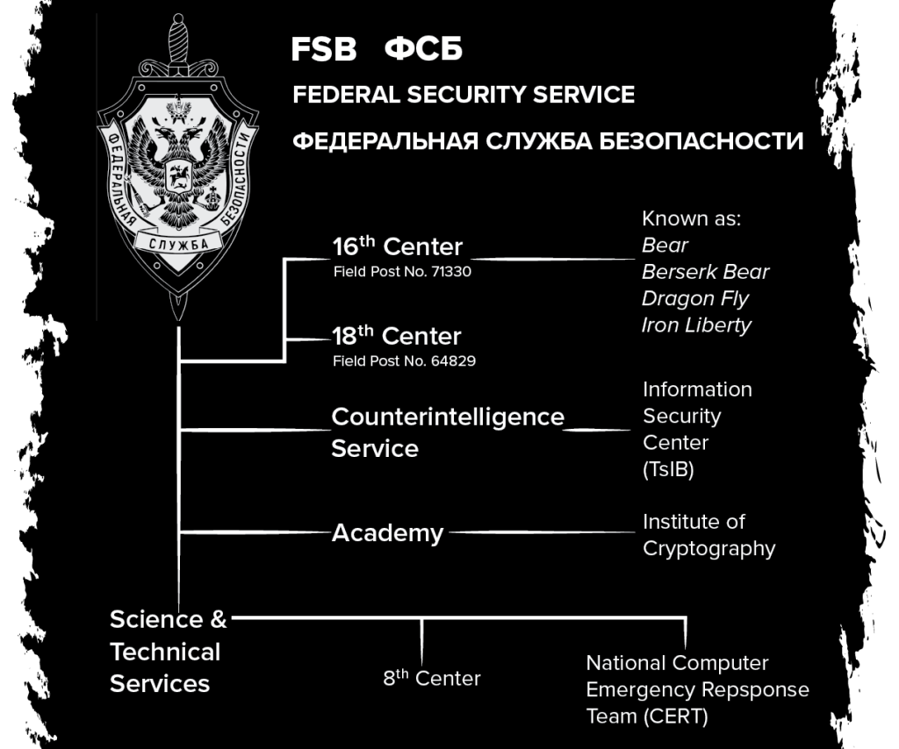
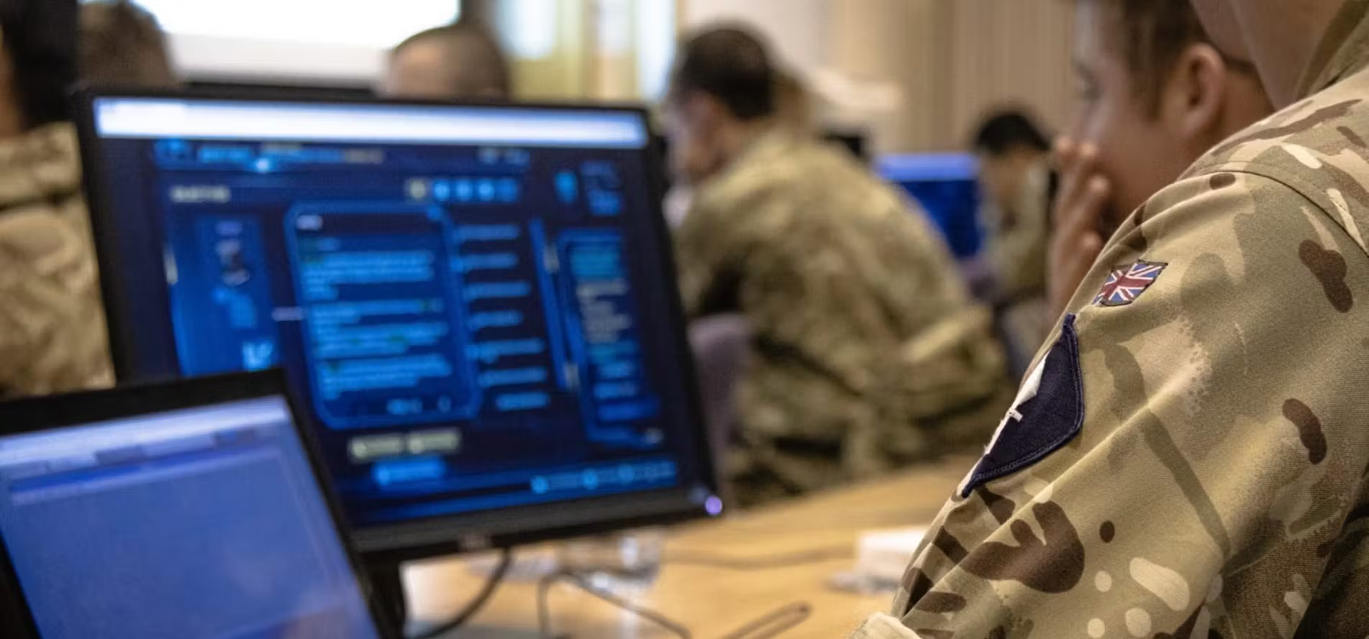
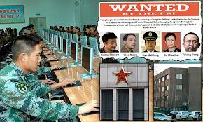
State-backed hackers (military affiliation)
Notes:
There are clear routes through the state to train in offensive hacking and attach to such units

Slide 17
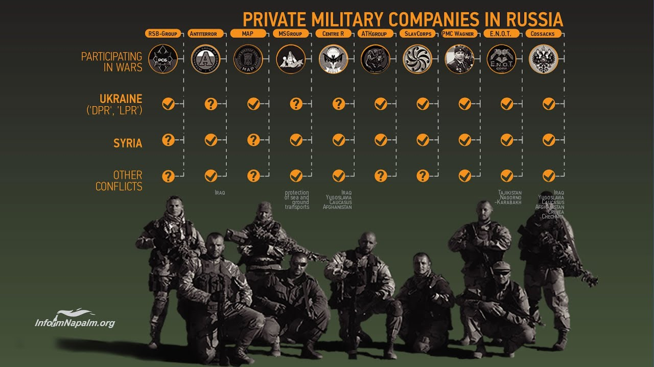
State-backed hackers (PMC affiliation)
Notes:
Not much info out there but I am sure they operate in the same way as the regular military with PMCs

Slide 18

Nation states in question?
Nation States of our focus:
Russia
China
Iran
North Korea
But… thats it right, surely the west don’t do any offensive cyber operations…
United States / Israel
United Kingdom
Other:
Vietnam
Notes:
vietnam/singapore cybercrime hotspots

Slide 19
What are the motives of an APT group (Why?)
03

Slide 20



China
Famous APT groups
PLA unit 61398 (APT1) - Operation Night Dragon (Shady RAT)
Salt Typhoon - IPS and Data Persistence
Flax Typhoon - IoT device hacking (BE CAREFUL)
Velvet Ant - Supply Chain attacks
Volt Typhoon - Stealth and Espionage
Famous attacks from these groups:
Operation Aurora - Stealing LOTS of designs/data from the west
Shady RAT - Stealing LOTS of designs/data from the west

Slide 21


Russia
Famous APT groups
Cozy Bear (APT29) - Solarwinds
FIN7
Sandworm
Berserk Bear
Famous attacks from these groups:
Solarwinds attack (APT29)
Supply Chain Attack against SolarWinds to infect users of solarwinds solutions
COVID disruption (APT29)

Slide 22
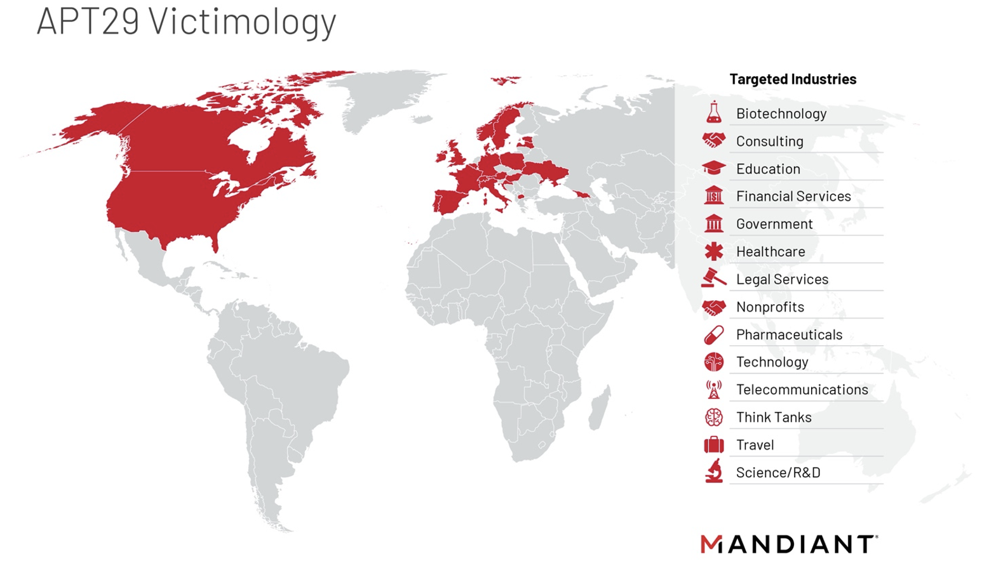

Slide 23
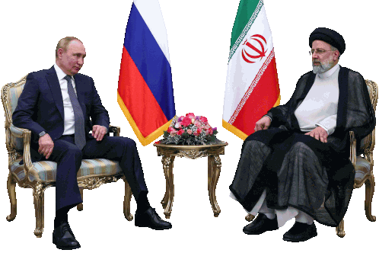

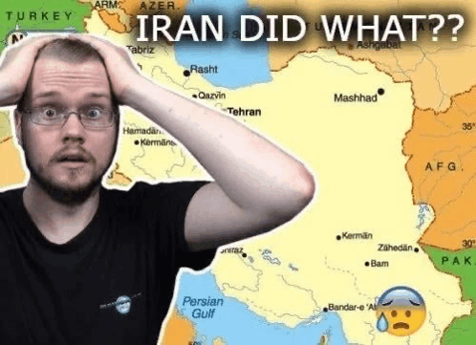

Iran
Famous APT groups
Charming Kitten (APT35)
Elfin Team (APT33)
Helix Kitten (APT34)
Pioneer Kitten
Famous attacks from these groups:
The bulk ordering of liquid peroxide from a wholesale shop down the road in Sheffield
DropShot and TurnedUp malware
Less “famous attacks” but still lots of operation, to gather intelligence and destroy/disrupt the west…

Slide 24


North Korea
Famous APT groups
Lazarus (APT38)
Kimusky (APT43)
Ricochet Chollima (APT37)
Famous attacks from these groups:
Sony Breach (2014)
Bangladesh Bank Heist (2016)
WannaCry (2017)
Remember, the NK economy is propped up on crime, cybercrime is a natural progression here… If you don’t believe me look at the north korean money laundering operation in europe and the americans having to change the design of the dollar note…

Slide 25



USA / Israel
Famous APT groups
Mossad unit 8200
Equation Group
These are the declared ones… (history is written by the victors and all that)
Famous attacks from these groups:
Stuxnet (really bloody cool tbh)
They don’t like to kiss and tell tbh… they are up to all sorts though I am sure
Who own the? (i won’t carry on with that one)

Slide 26



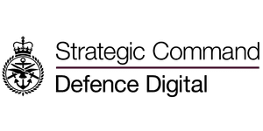




Slide 27


Shadow Brokers
Shadow Brokers are not an APT group but are a very good example of a sophisticated non-APT group…
This group hacked the Equation Group / NSA and exposed their stash of zero-day vulnerabilities including the EternalBlue vulnerability. This was one of the zero-day compromises used in the Stuxnet attack, when talking about the TTPs of an attacker.
The ability to do this and get into the NSA shows a high level of sophistication, maybe they did have state help maybe not. My point is that all threats can be an advanced threat it really does depend

Slide 28
How do these attacks happen? (How?)
04

Slide 29
Past Attacks
APT29 - Solarwinds
USA/Israel - Stuxnet
A famous supply chain compromise into the solarwinds company and their customers
An extremely advanced attack targeting ICS elements of the natanz nuclear enrichment facility in Iran.
Lazarus/ShadowBrokers - Wannacry
Other attacks
A large scale ransomware attack using the eternalblue exploit, most notably against the NHS
There are plenty! Do your research!

Slide 30


Slide 31
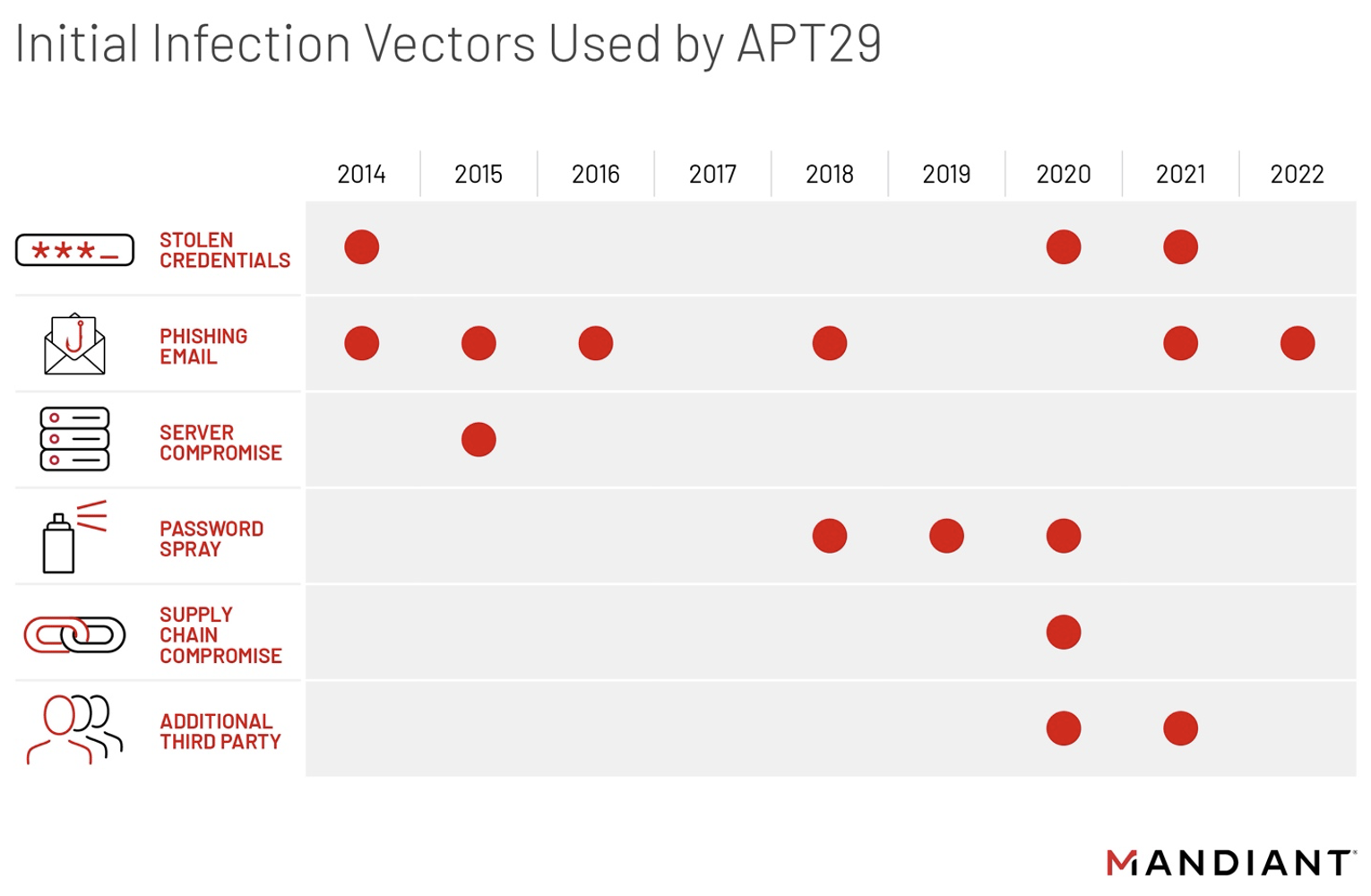
Notes:
Orion software compromised
Trojan to orion customers
12-14 day dormant period
Once access acquired, escalate and data theft, undetected for months

Slide 32
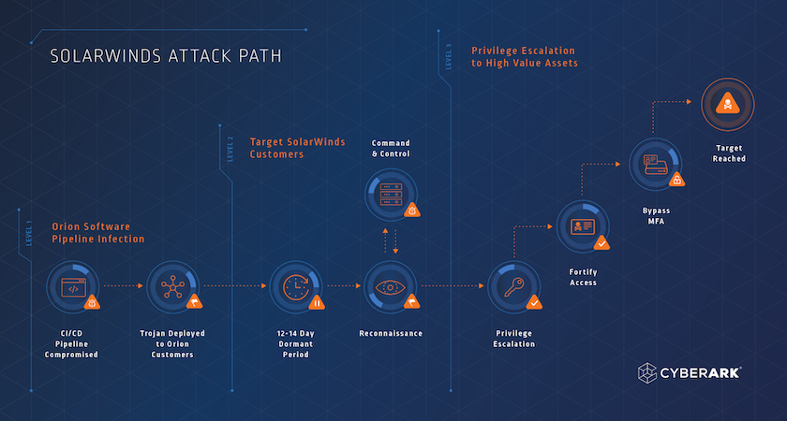
Solarwinds
Notes:
Orion software compromised
Trojan to orion customers
12-14 day dormant period
Once access acquired, escalate and data theft, undetected for months

Slide 33
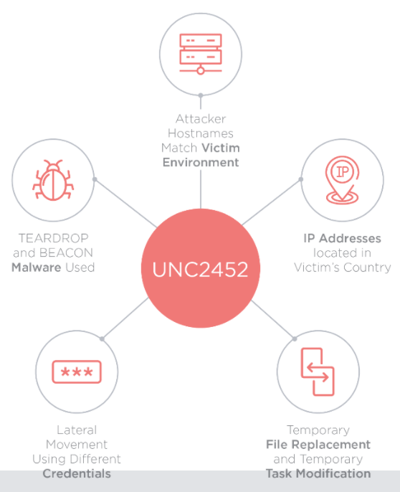
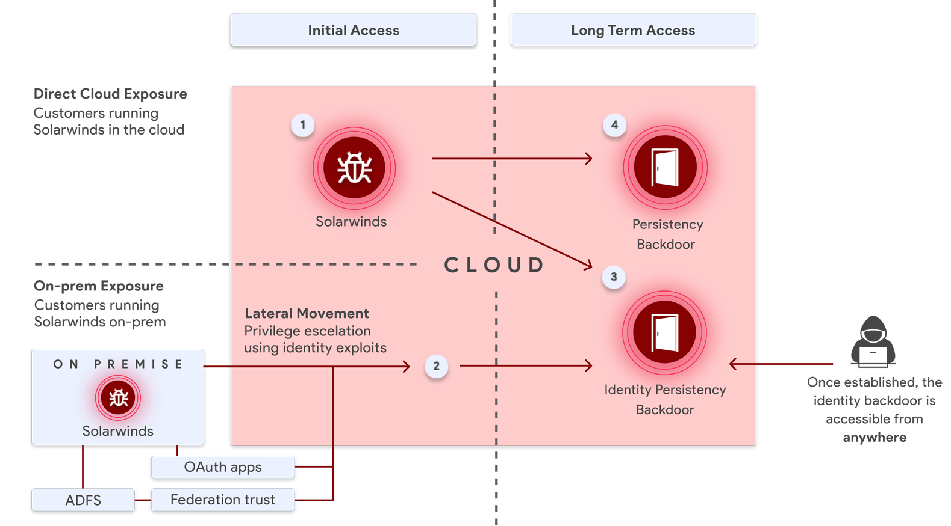
Solarwinds

Slide 34


$90,000,000
Estimated loss from the solarwinds breach…

Slide 35
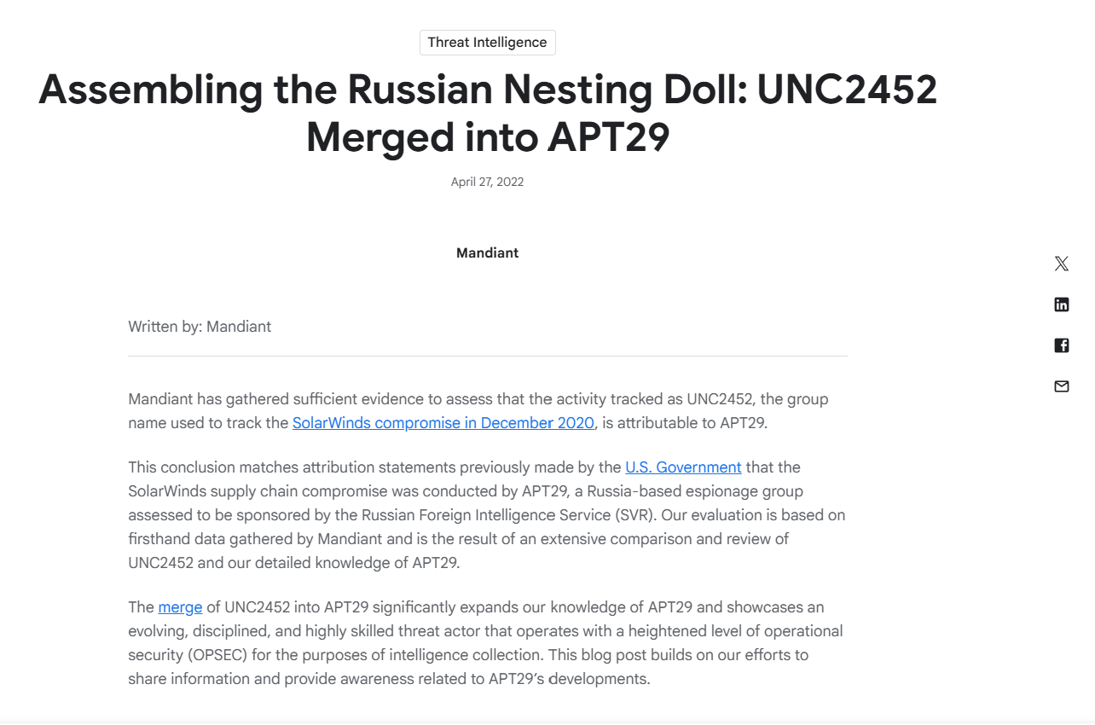
More Information - Mandiant report

Slide 36
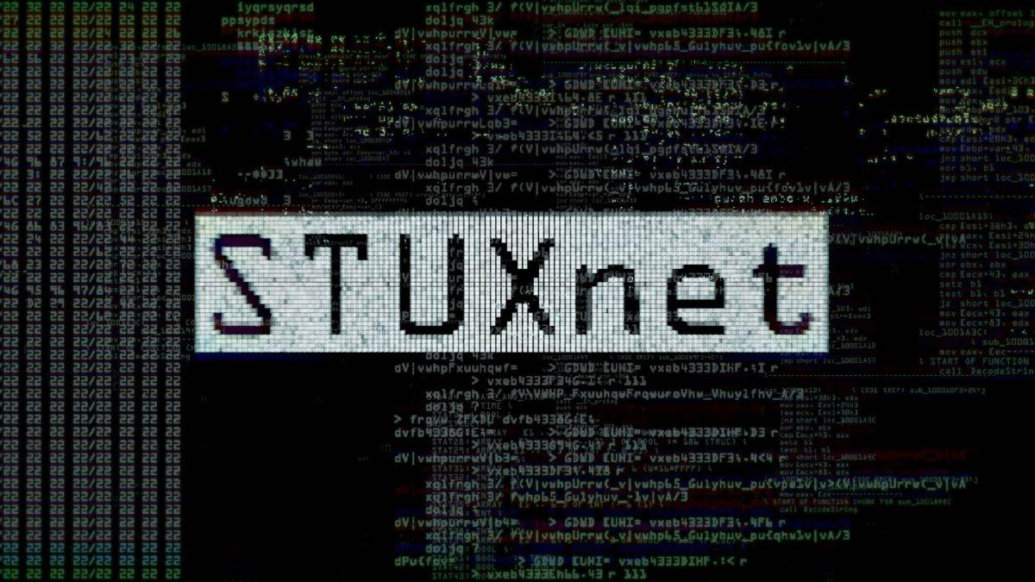

Slide 37
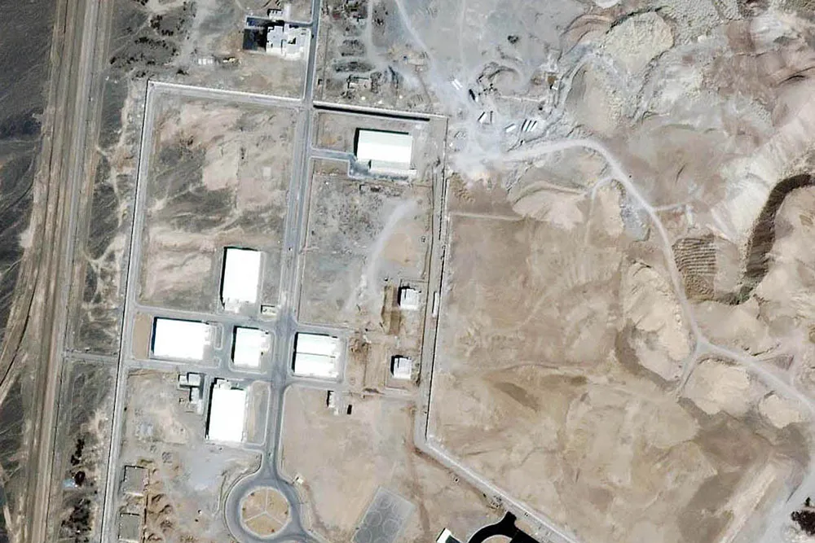

Slide 38
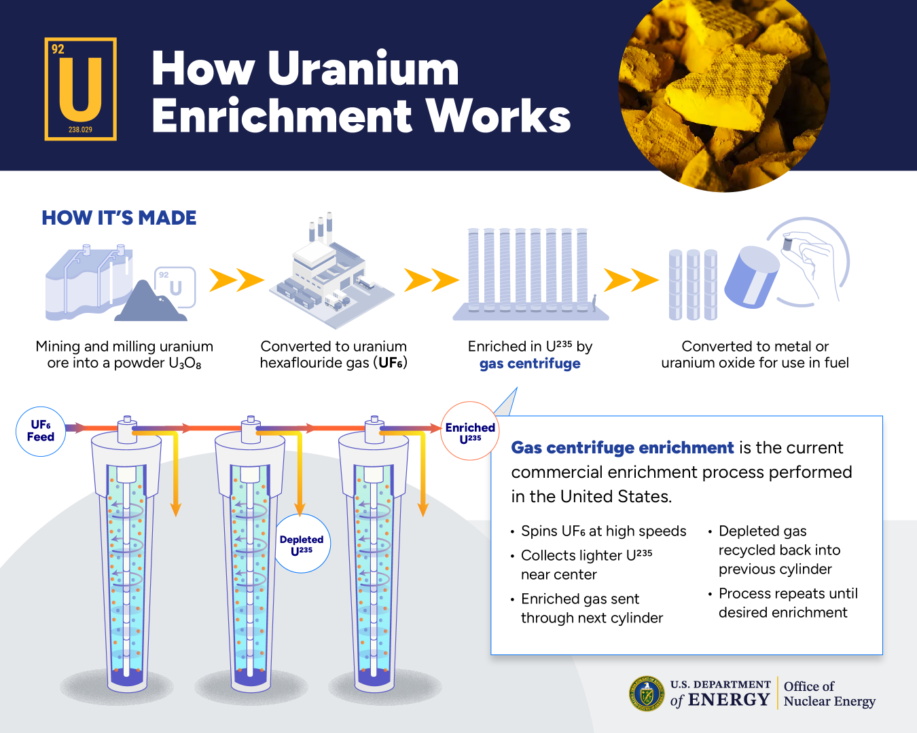

Stuxnet

Slide 39
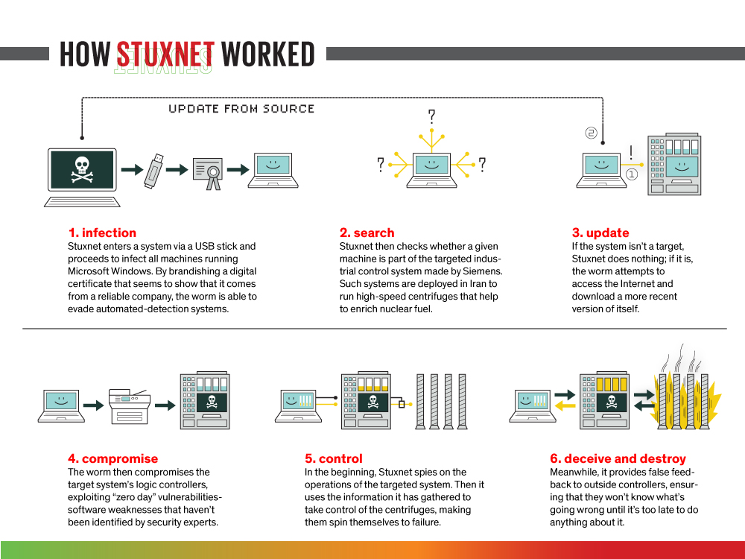
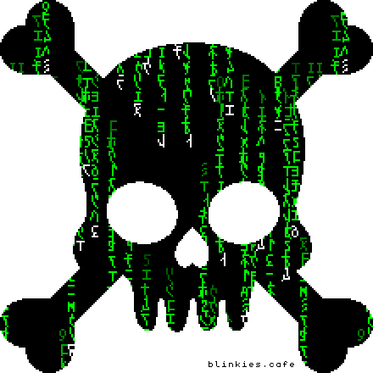
Stuxnet

Slide 40


Stuxnet
Targets?
People?
Process?
Supply Chain?
In this attack, the israelis wanted to strike the Natanz facility with laser guided munitions, hence why when the complex was rebuilt, they built it deep underground requiring U.S. JDAM munitions to compromise…
The U.S. replied with, let’s take the quiet option and hit the site using malware instead…
The state had already acquired unrefined uranium and centrifuges via a proxy, so time was against the west to prevent the enrichment of uranium… Nuclear Inspections had reported that Iran was preparing the first batch of uranium to be enriched…

Slide 41
Stuxnet
Initial Compromise?
USB Drop - This was an air-gapped network so physical access was required
Establishing a foothold?
The malware exploited the EternalBlue vulnerability to gain access to the machines in the complex, searching for the ICS equipment… The malware once propagated would delete itself on the not required device to avoid detection
The attack?
The malware exploited several other zero-day vulnerabilities to take control of the PLCs, controlling speed of centrifuge operation, creating a resonance that shook the unit to the point of self destruction…
Pretty clever right?

Slide 42
Stuxnet
Dropping malware via a USB into an air-gapped facility, one of the most secure places on earth is no small feat, they had practice…
The hackers had performed smaller attacks on the complex previously, each time compromising in a different way to avoid detection and make it seem like the plant was simply malfunctioning, they also had a facility in the US, to test the compromise live on a mock Natanz facility… By the time this was set free, they knew that it would work (sort of)...
Once set free, they waited… After a few months, the Iranians started reporting that their centrifuges were having issues and going into destruct…
Did the US then claim responsibility and taunt them?
NO
They simply sat there, causing uncertainty in the plant and fear among the Iranian Government…

Slide 43
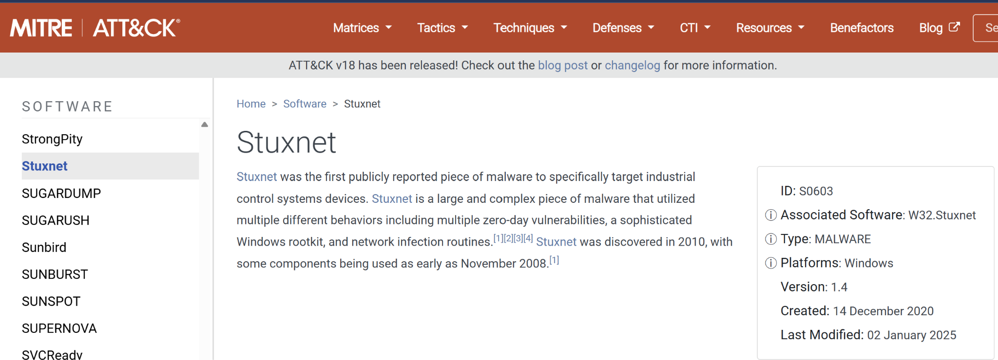
Stuxnet - Precursor attacks
There were several precursor attacks to the main stuxnet compromise, designed to gather intelligence and compromise the centrifuge operation in different ways
The clever tactic used by the threat actors was to compromise a different part of centrifuge operation every time, making it look like general malfunction and not compromise…

Slide 44
Stuxnet - The moral of the story..
A complex attack like this takes time, money, expertise and experience… This is what defines a nation-state attack compared to the other types of threat actor…
Simple Tactics, Tools and Procedures can be tied to these groups and suddenly, a picture can be painted as to who did the attack and why…

Slide 45
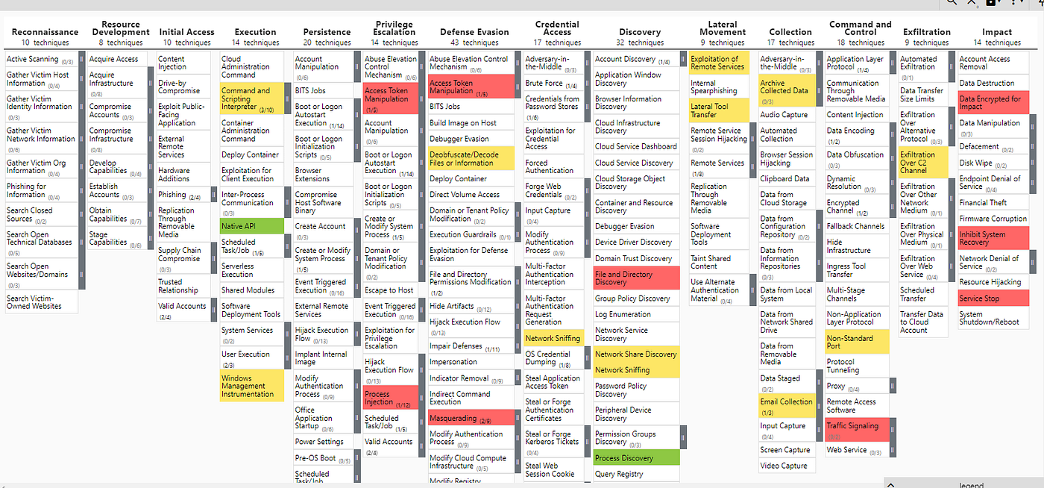
MITRE ATT&CK Framework

Slide 46
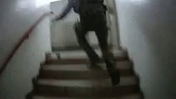
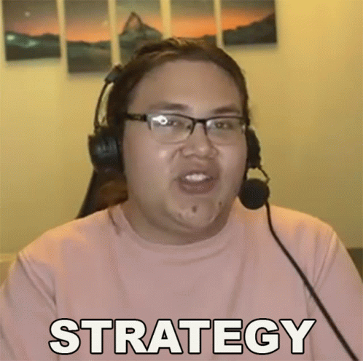
Analysing TTPs and attribution to an APT
To fingerprint an attack and attribute it to an APT group, we need to look at the tactics, tools and procedures that have been displayed, from the entry vector, to the c2 software used and how persistence was established…
Now, let’s look at some tactics seen in a real-world attack and where we can acquire said information from as a blue team operator

Slide 47


The Lazarus Group (NK)
Famous Attack: 2014 Sony Breach
Crypto Theft
DDoS
Extortion
Side-loading malware
Major financial and political motive, in the 2014 breach the main focus was to disrupt Sony as they set to release “The interview”. Politically, the DPRK disagreed with the portrayal of their beloved leader and so set out to deny Sony the right to release said film…

Slide 48
The Lazarus Group (NK)
TTPs:
Phishing
T1566.001 - Spear Phishing
Credential Compromise
T1003 - OS Credential Dumping
Recon Module
T1087 - Account Discovery
T1018 - Remote System Discovery
Dropper
T1204.002 - User Execution: Malicious File
Signed Malware
T1553.002 - Subvert Trust Controls: Code Signing

Slide 49
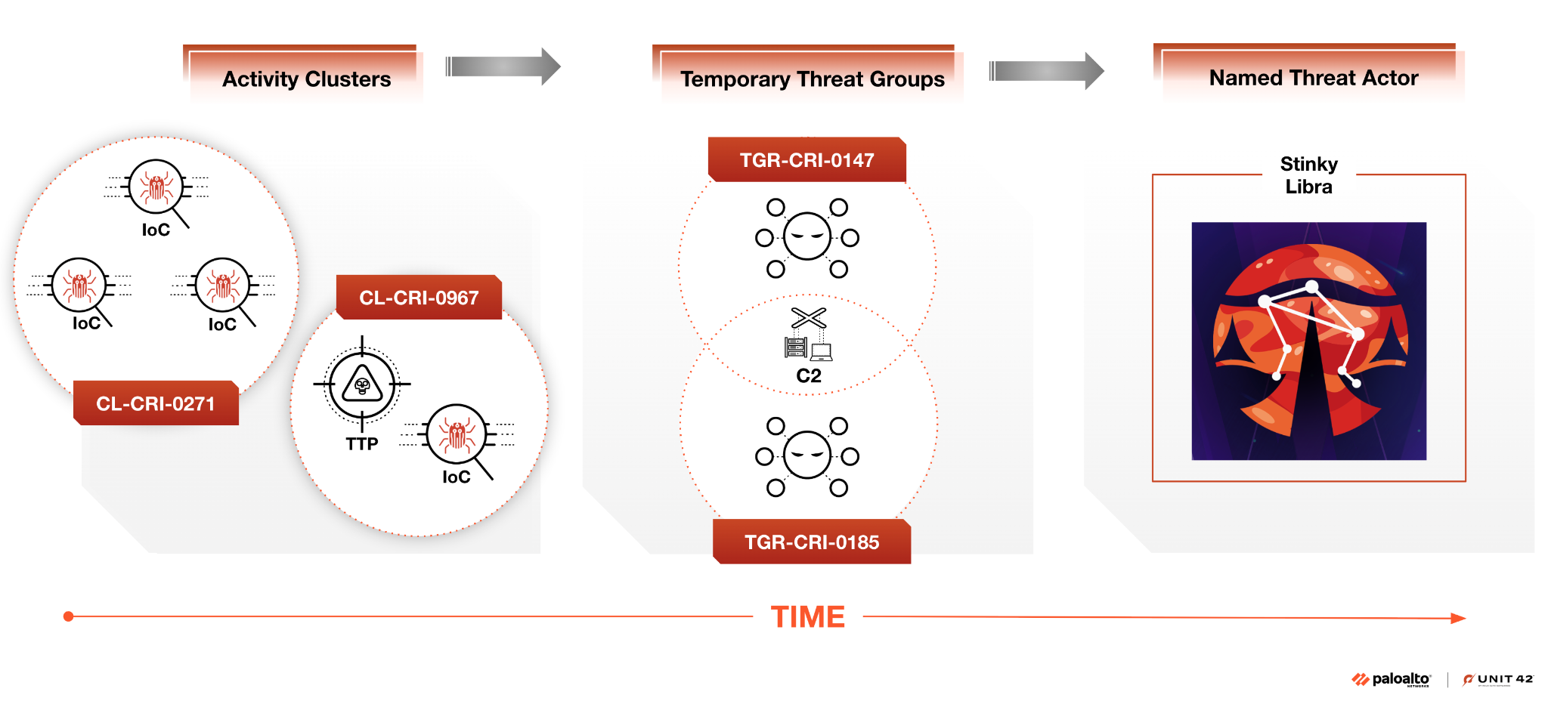

Slide 50
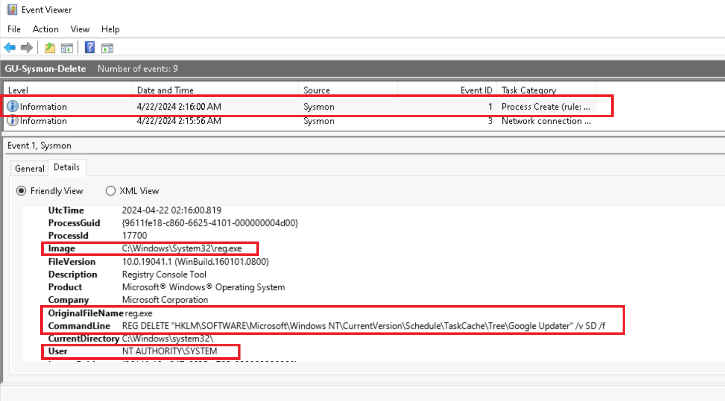
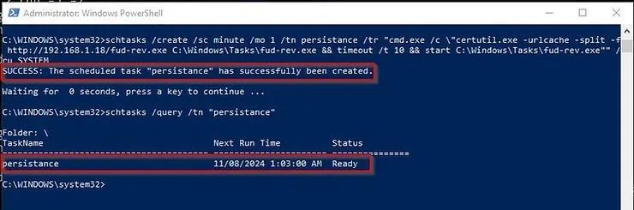
Where can we find these TTPs?
Endpoint/Host Evidence:
EDR alerts (process trees, parent/child execution)
Memory Captures (volatility.py)
Disk Artefacts (binaries, scheduled tasks)
Credential dump traces, registry changes, new services)

Slide 51
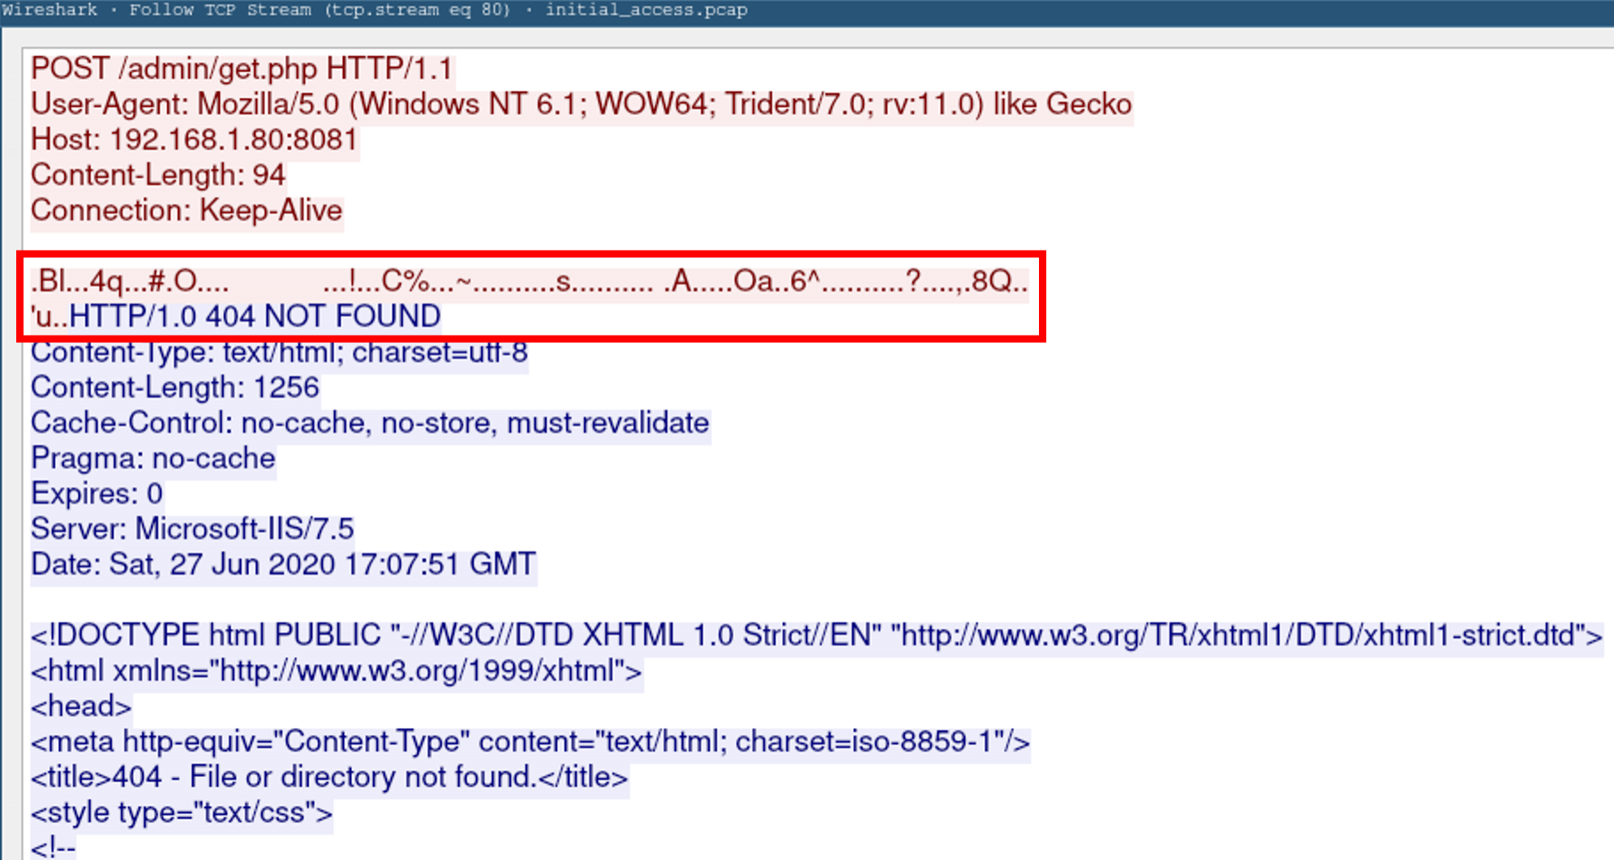
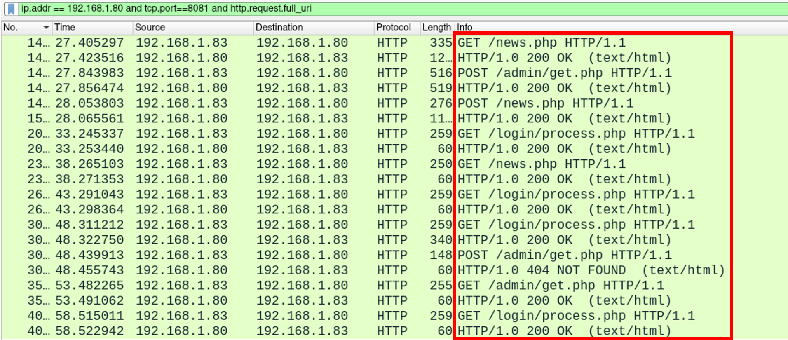
Where can we find these TTPs?
Network and C2 Indicators:
Unusual outbound connections (proxychains, encrypted C2 traffic)
DNS Tunneling, HTTPS anomalies, beaconing patterns
PCAP analysis (protocol misuse)

Slide 52
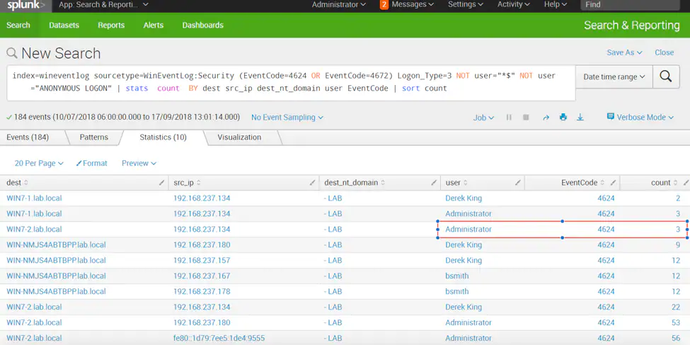
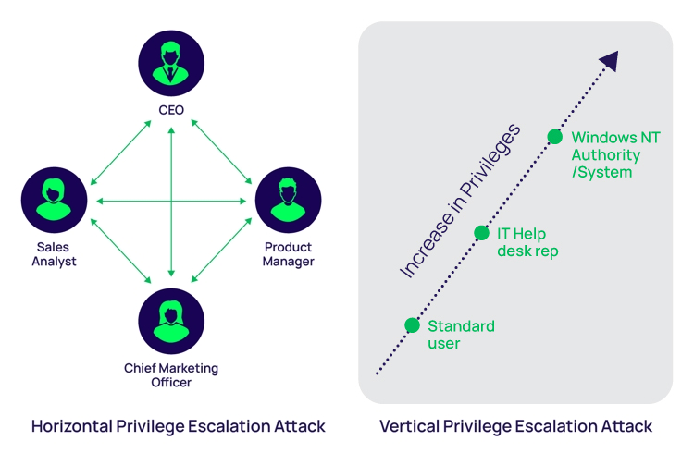
Where can we find these TTPs?
Authentication and Identity Logs:
Privilege escalation (Admin, Domain Admin events)
Lateral Movement via SMB/WinRM/RDP
Account creation, disabled logs, failed brute attempts

Slide 53
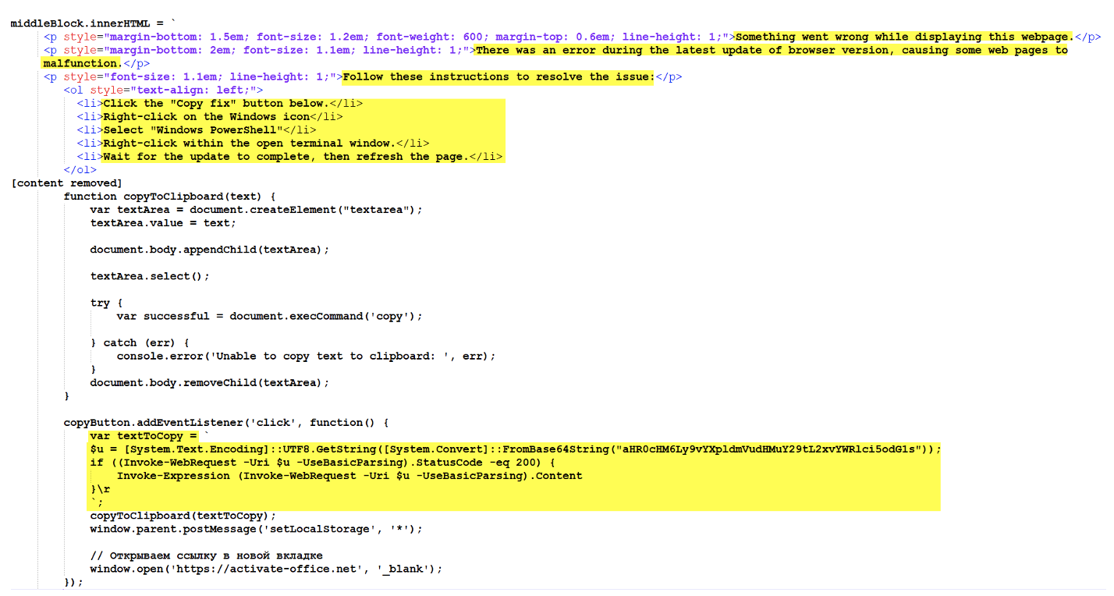
Where can we find these TTPs?
System & Application Logs:
Powershell, WMI, Bash history, cron/schtasks
Apache web logs (uploads, shells)
Email logs (phishing, attachments)
Cheeky self pwn ;) →

Slide 54
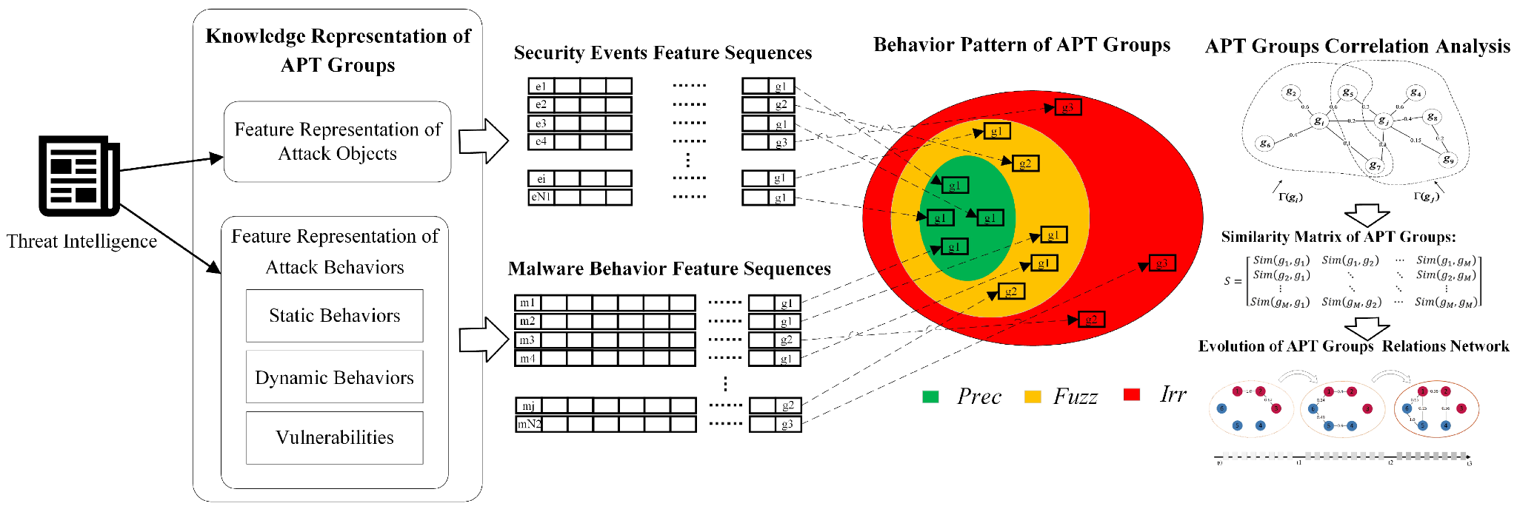
Where can we find these TTPs?
Malware Analysis Outputs:
Droppers, Loaders, RATs, wipers
Code/signature reuse (Previous APT signatures)
Hardcoded C2, Crypto keys, signing certificates

Slide 55

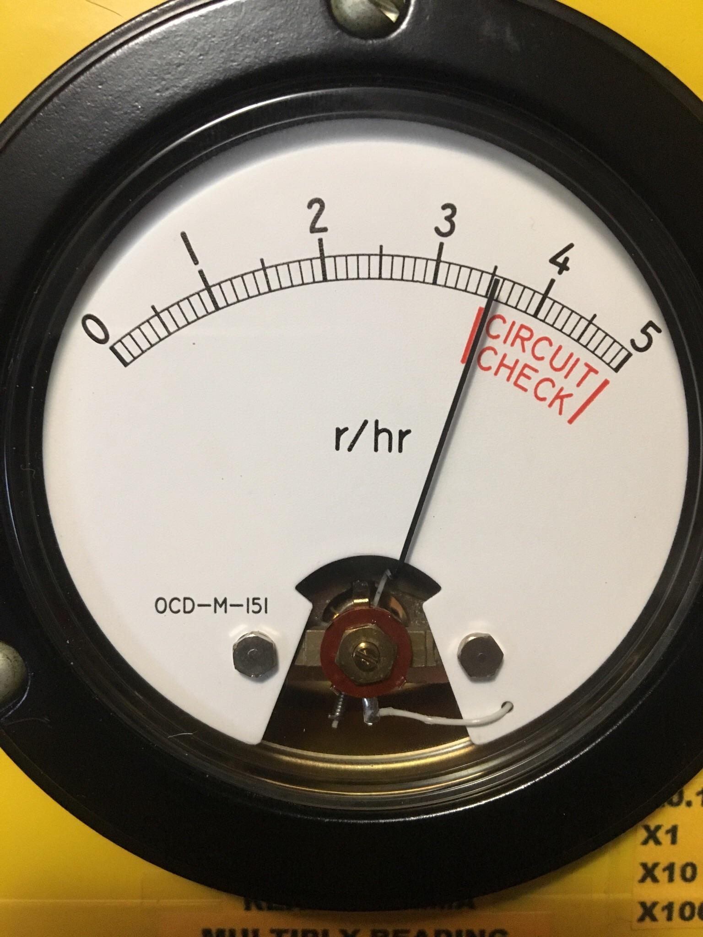
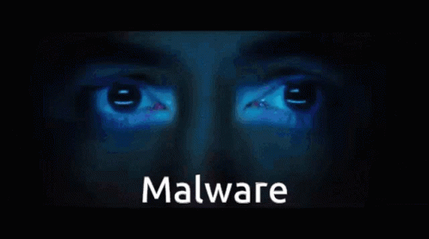
Affiliated Roles
Defensive Cyber
SOC Analyst L1
CTI Analyst / Detection Engineer
Malware Analyst
Responding to alerts generated by IDS/IPS/SIEM and escalating incidents
Analysing CTI data and TTPs to improve the defensive posture of the organisation
Decompiling and analysing malware for signatures/indicators (attribution)

Slide 56
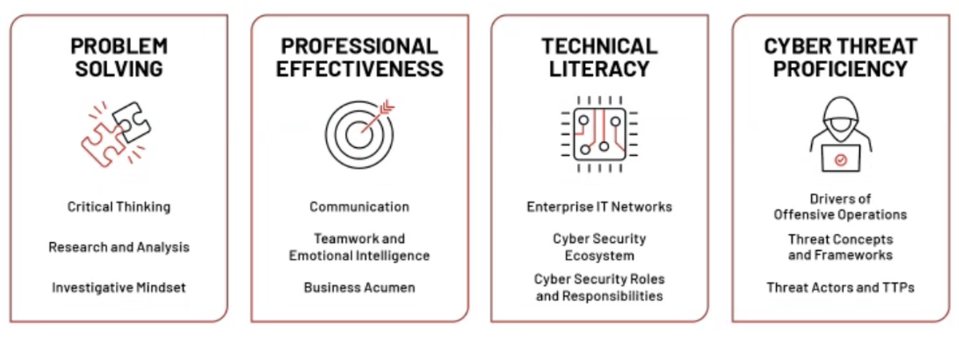
Affiliated Roles

Slide 57
Conclusion
A = You now never want to touch blue teaming again
B = I have convinced you that blue teaming can be interesting
C = You were asleep
Related roles to this talk…
CTI (Cyber Threat Intelligence) Analyst
SOC Analyst
Malware Analyst/Reverse Engineer
Incident Responder (IR)

Slide 58

The practical :)
https://tryhackme.com/room/
apt28inceptiontheory

